Slide 1
secure data hiding in images using steganography
CAPSTONE PROJECT
Presented By : GEERTHIVASH J.D.
Student Name : GEERTHIVASH J.D.
College Name & Department : SAVEETHA ENGINEERING COLLEGE - ECE

Slide 2
OUTLINE
Problem Statement
Technology used
Wow factor
End users
Result
Conclusion
Git-hub Link
Future scope

Slide 3

Problem Statement
In an era of cyber threats, secure communication is essential for military, intelligence, and confidential operations to prevent data breaches and unauthorized access.
Sensitive data transmission is at risk due to increasing cyber threats, espionage, and surveillance.
Traditional encryption can be easily detected, making confidential communication a target for interception.
Stealthy data embedding techniques are needed to safeguard sensitive communications from adversaries and cybercriminals.

Slide 4
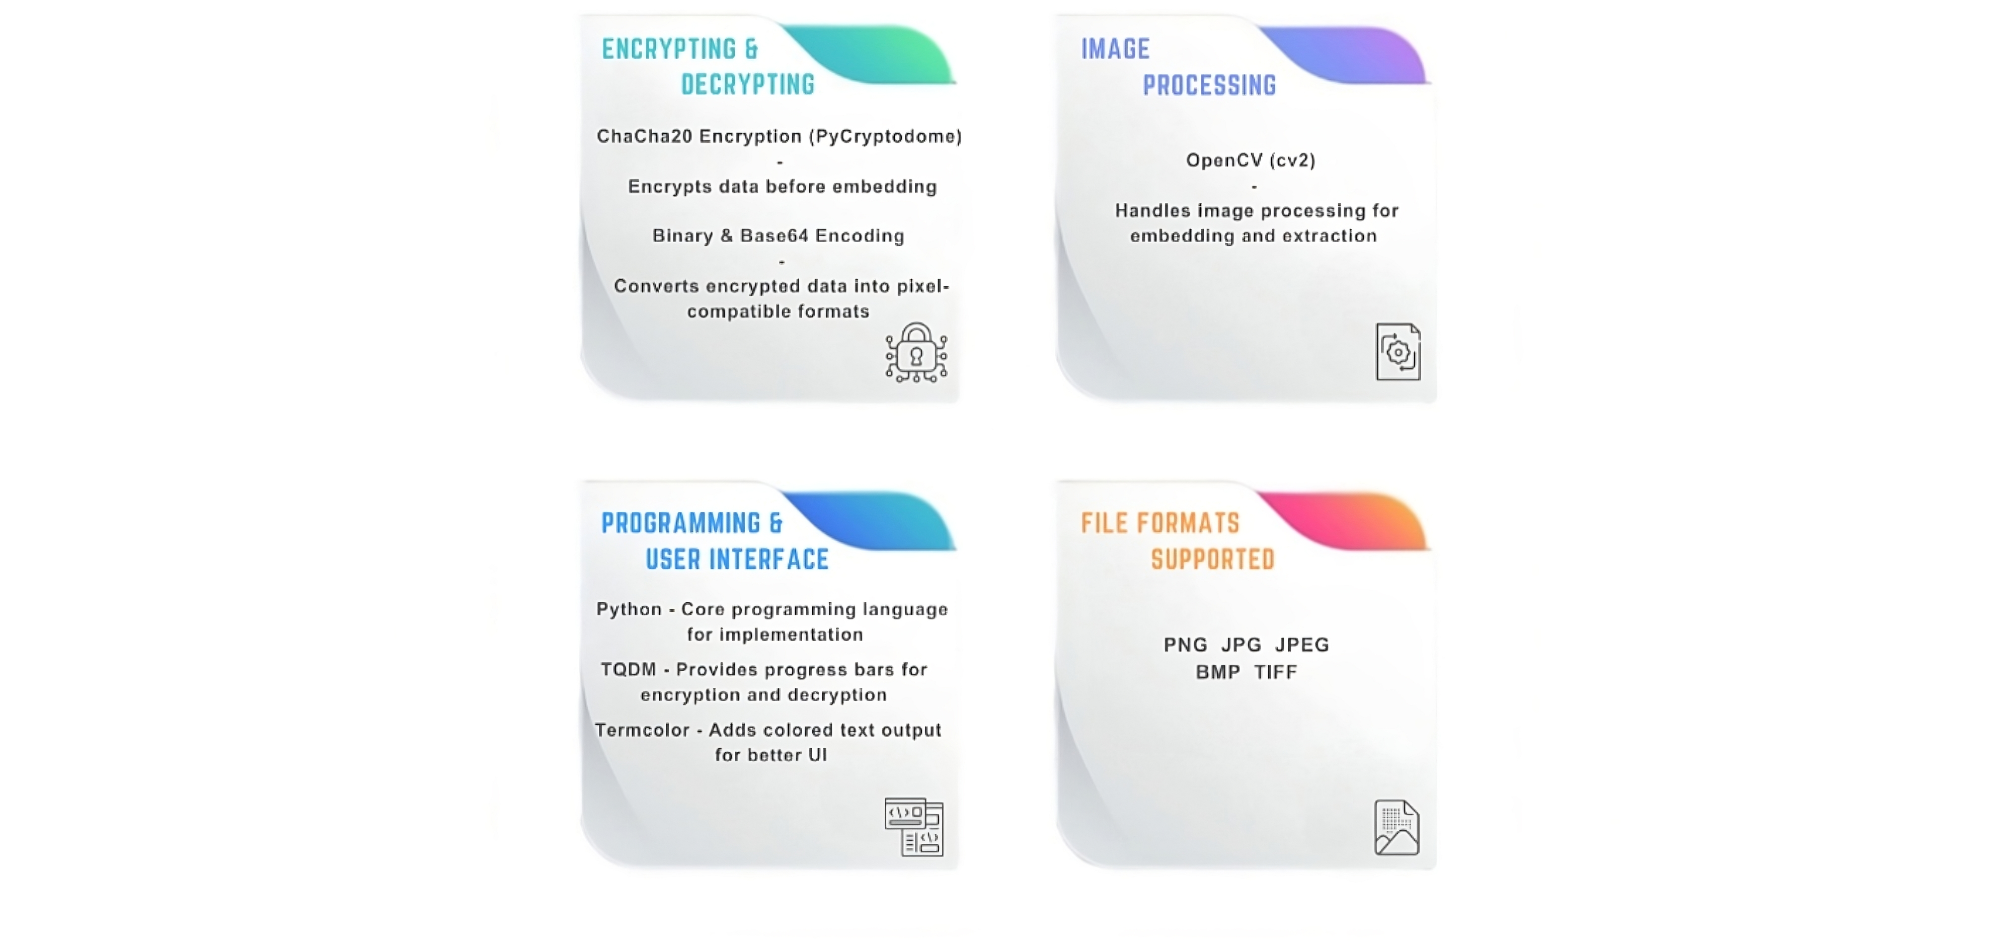
Technology used

Slide 5
Wow factors
FEATURES | OUR PROJECT | TRADITIONAL/OTHER PROJECTS
Encryption Strength | ChaCha20 - Faster and secure than AES | Basic XOR or AES encryptions
Stealth and Detectability | Hard to detect - Steganalysis resistant | Easily detectable using Forensic tools
Progress tracking | Live encryption and decryption progress - TQDM | No real time feedback
User interface | Color-coded CLI for easy interaction | Plain text commands
File Support | PNG,JPG,JPEG,BMB,TIFF - No quality loss | Lossy formats cause distortion
Large File Handling | Supports embedding large data efficiently | Limited data capacity

Slide 6

End users
ANALYSTS
JOURNALISTS
&
ACTIVISTS
RESEARCH
OUR PROJECT
MILITARY
GOVERNMENT &
INTELLIGENCE AGENCIES

Slide 7
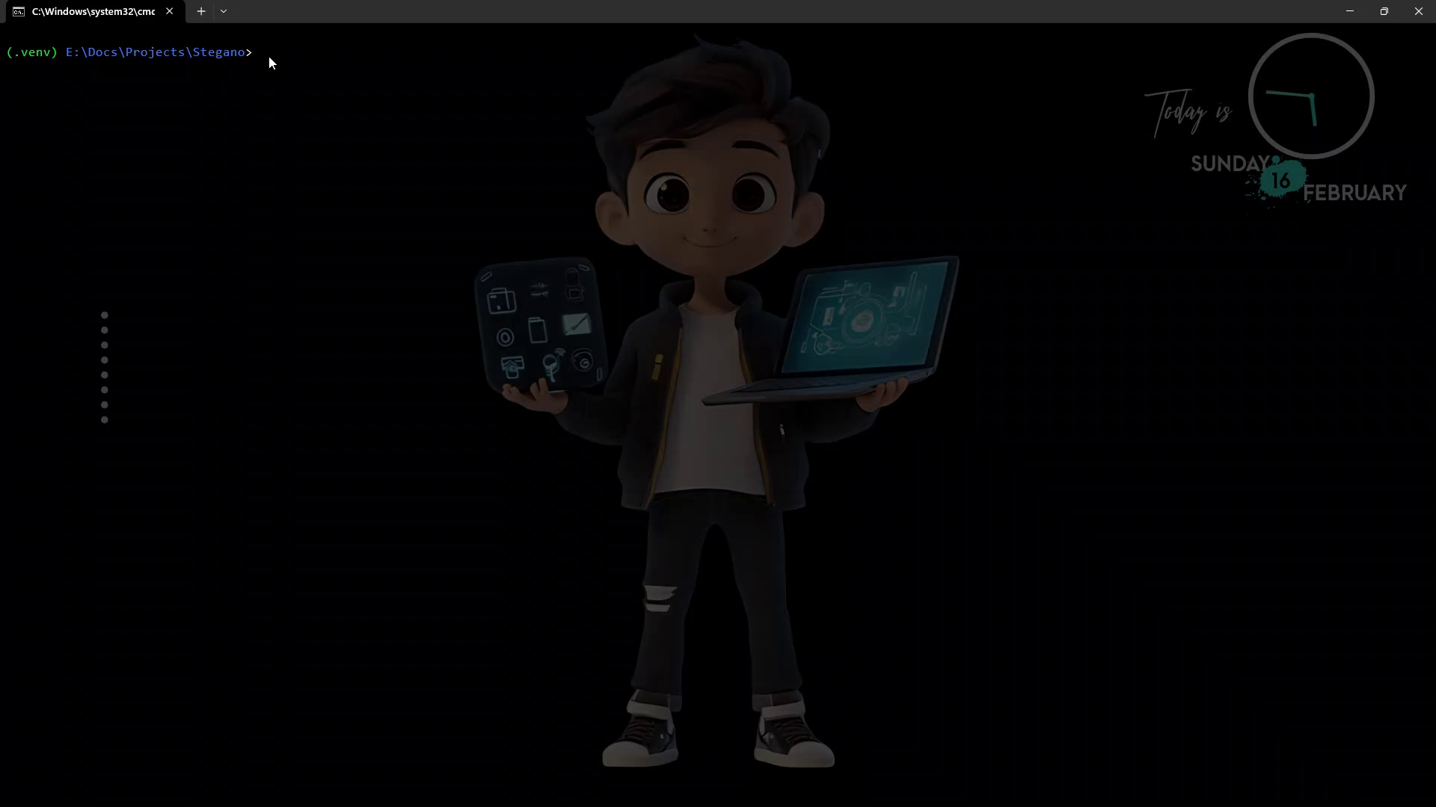
Results

Slide 8
Conclusion
Our project is not just another steganography tool—it’s a powerful and secure way to hide sensitive information without leaving a trace.
By combining ChaCha20 encryption, advanced image processing, and forensic-resistant techniques, it ensures that data remains both hidden and protected.
As technology evolves, so do the challenges of data security. Our project is a step forward in staying ahead of threats, offering a robust and accessible way to safeguard information in an increasingly digital world.

Slide 9
GitHub Link
https://github.com/Geerthivash/Shadow-C20

Slide 10
Future scope(optional)
Video & Audio Steganography – Expanding beyond images to embed hidden data in videos and audio files.
Multi-Platform Support – Expanding compatibility across Windows, Linux, macOS, Android, and iOS
Mobile & Web Integration – Developing a user-friendly mobile app and web version for easy accessibility.

Slide 11
THANK YOU

